Slide 1
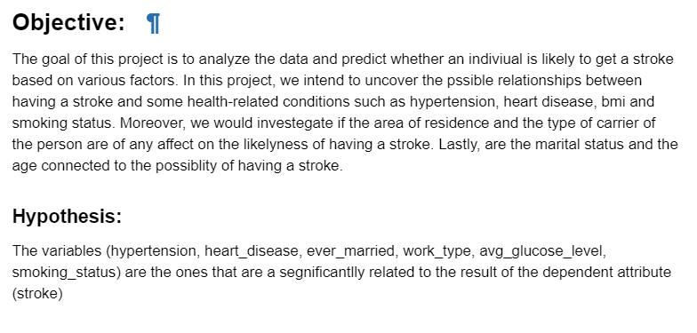

DISCOVERY
Source:

Slide 2
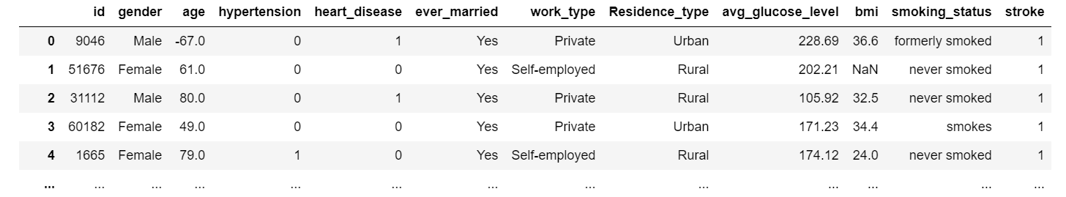
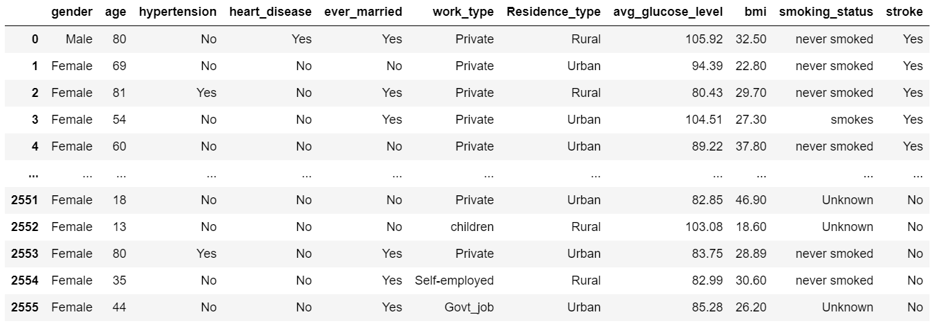
DATA PERPARATION
Before
cleaning
After
cleaning

Slide 3
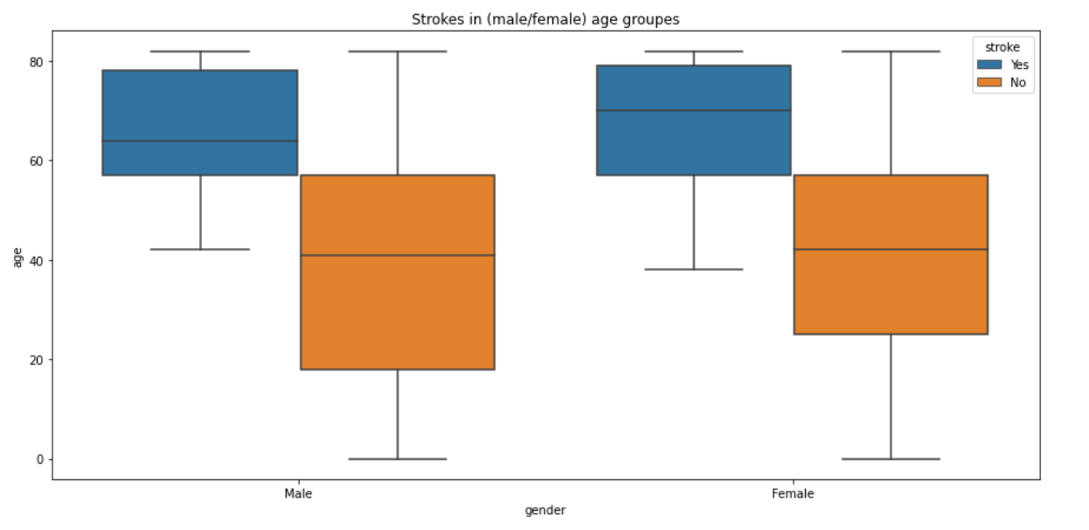
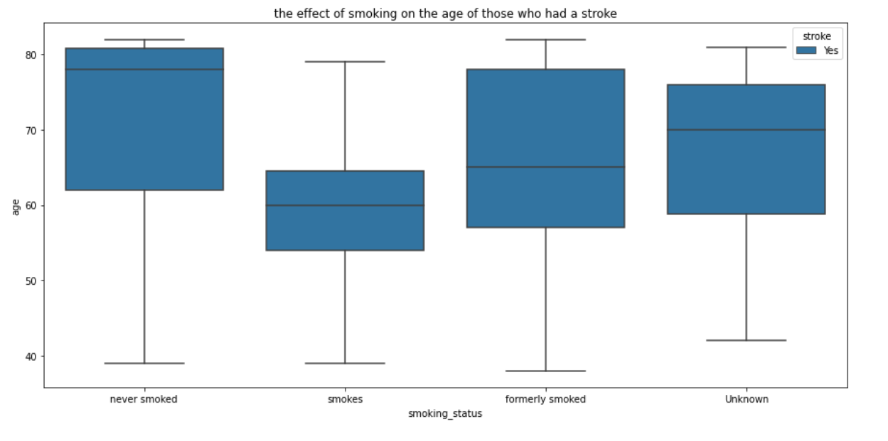
MODEL PLANNING

Slide 4
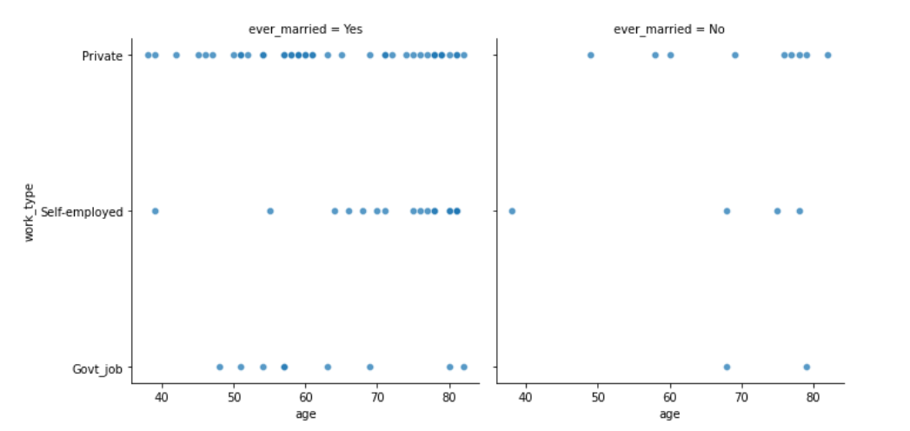
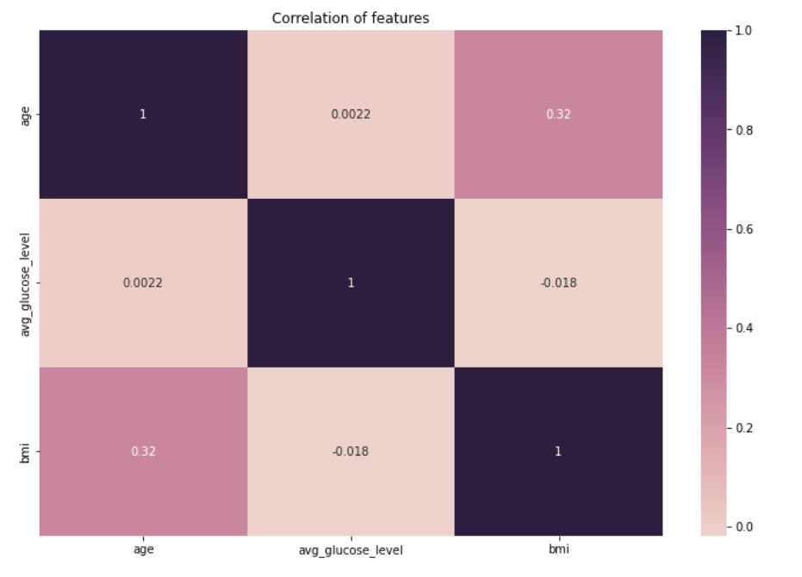
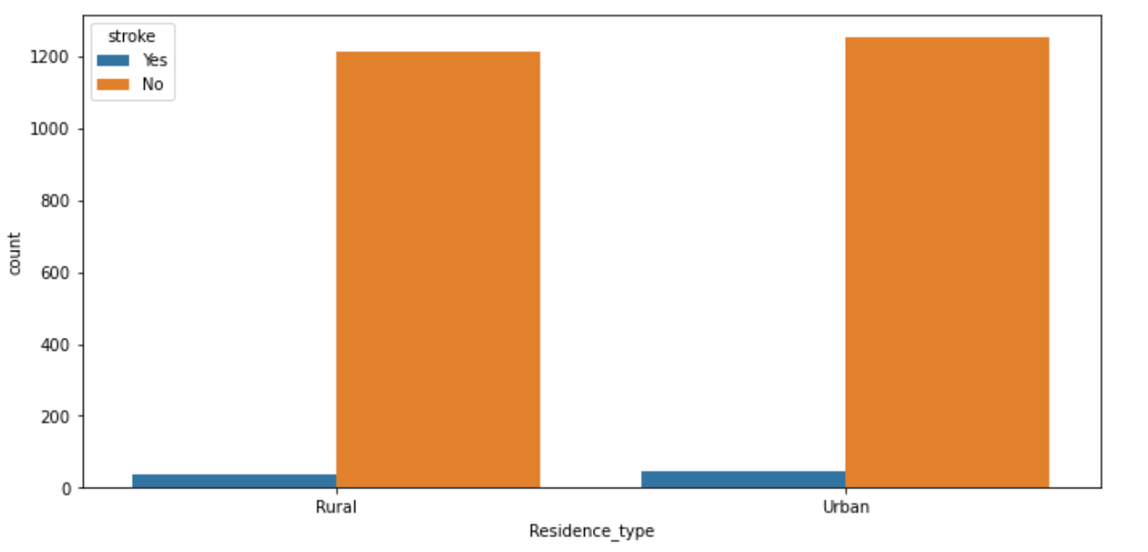

Slide 5
MODEL BUILDING
The ideal model : Classification models.
Reason: as our objective is to forecast whether a person will have a stroke or not, it is the ideal job for the classification models to draw this conclusion from the analyzed data after the training and the testing

Slide 6
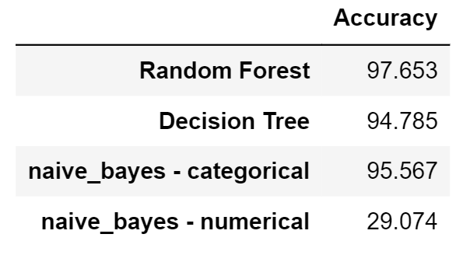
Data split
Training | Testing
70% | 30%

Slide 7
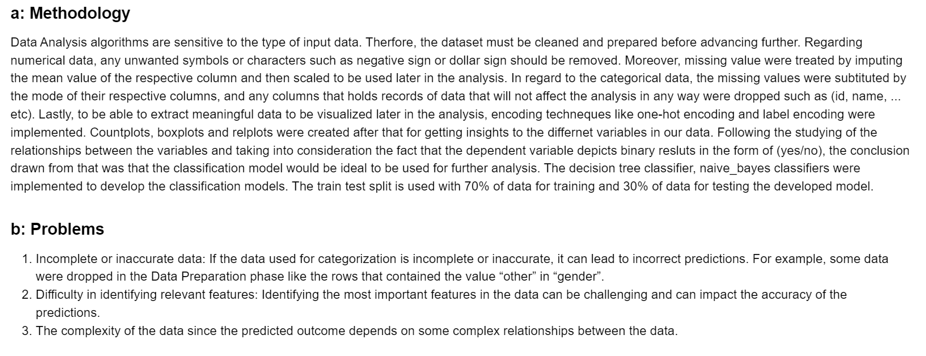
OPERATIONALIZE

Slide 8
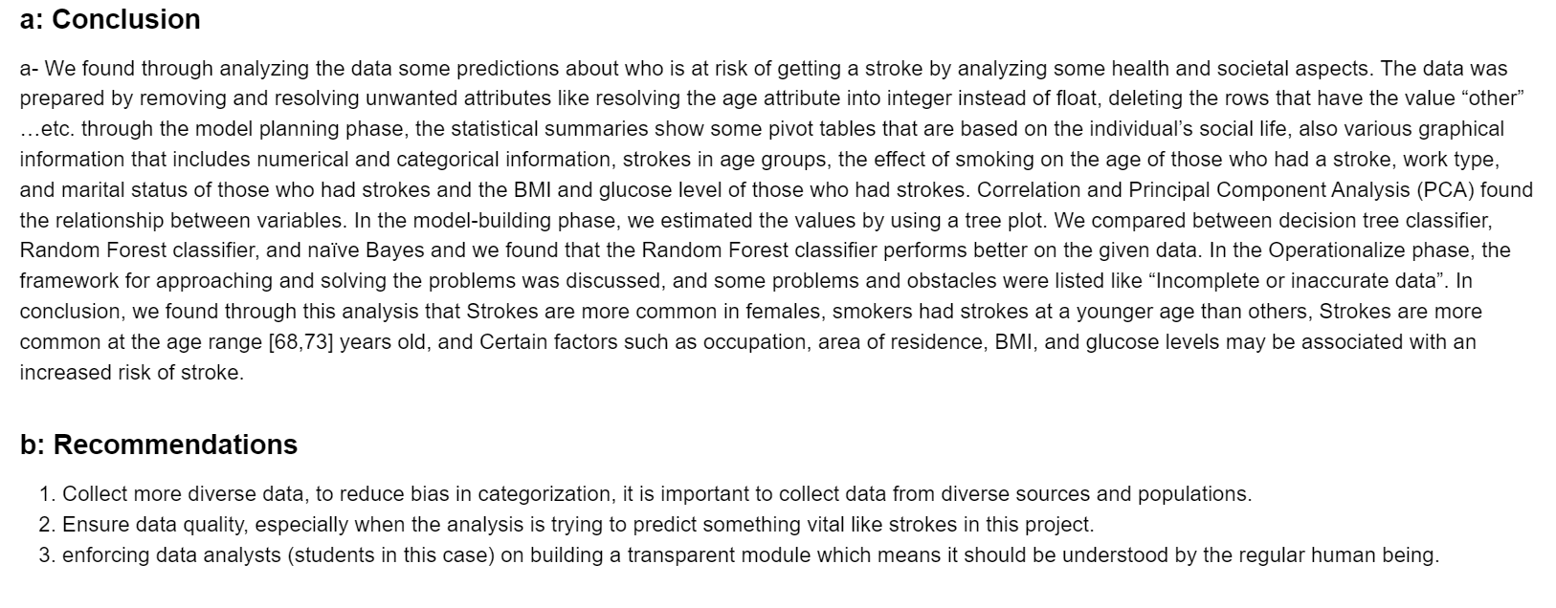
COMMUNICATE RESULTS

Slide 9
THANK YOU
&
GOOD LUCK

